Slide 1


Naive Binding Affinity Shapes Clonal Selection and Evolution in the B-cell Response to SARS-CoV-2 vaccination
Thomas Dupic
October 25th 2026, Normal and Malignant B-cells workshop

Slide 2
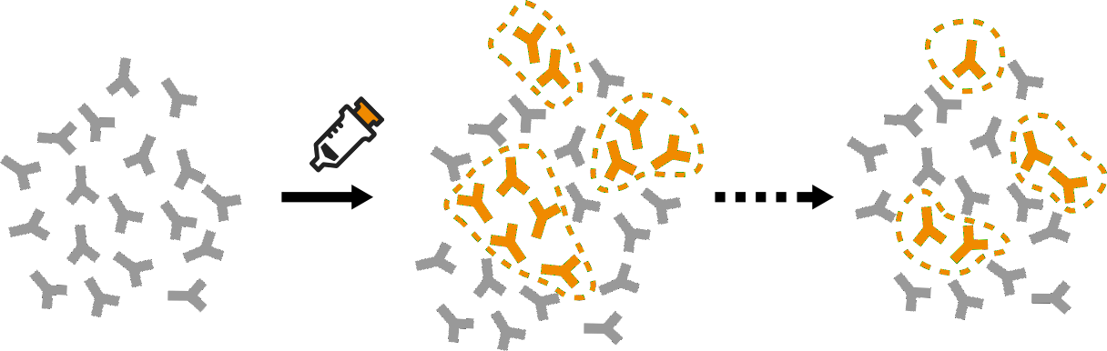

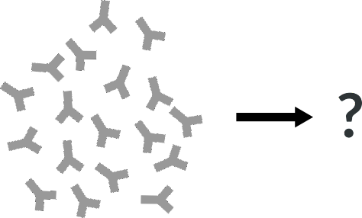
Tracking lineages fates’
Can we identify the responding lineages?
Can we predict the evolution of a repertoire?

Slide 3
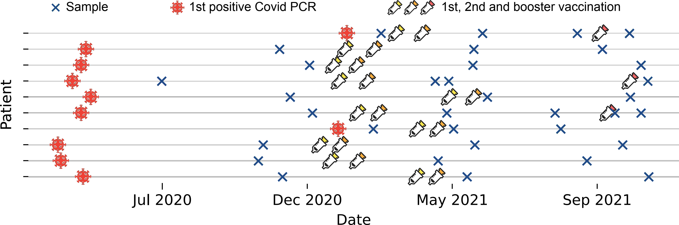
Longitudinal Repertoire Sequencing
Heavy
Longitudinal sampling on 10 individuals. Collaboration with the Yu lab at the Ragon institute, 10⁹ B cells. Heavy & Light chain.

Slide 4
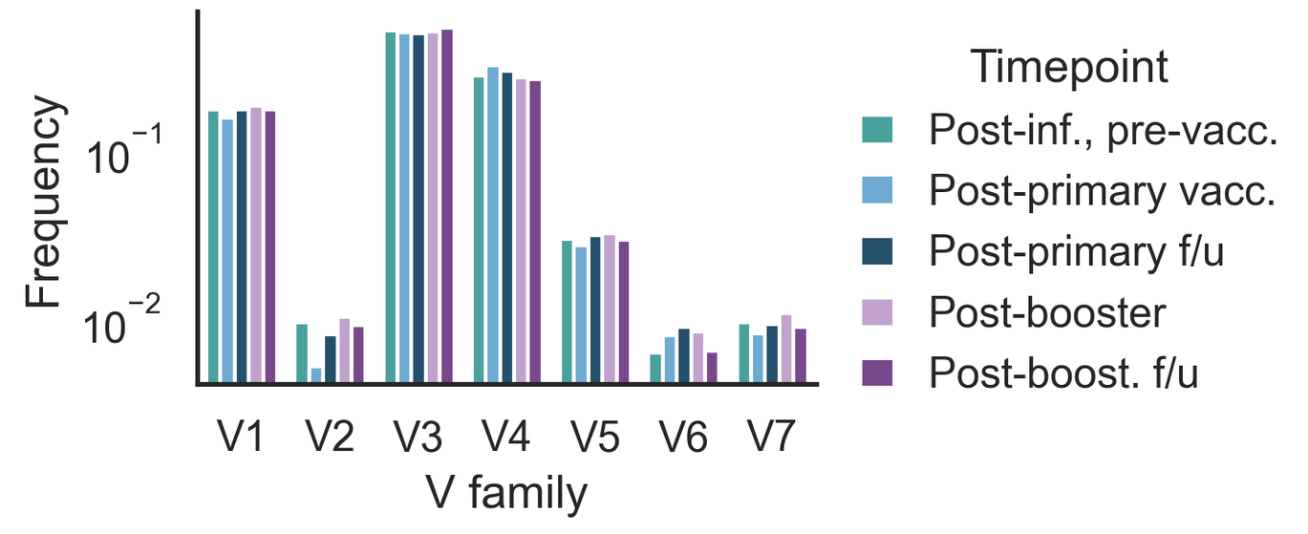
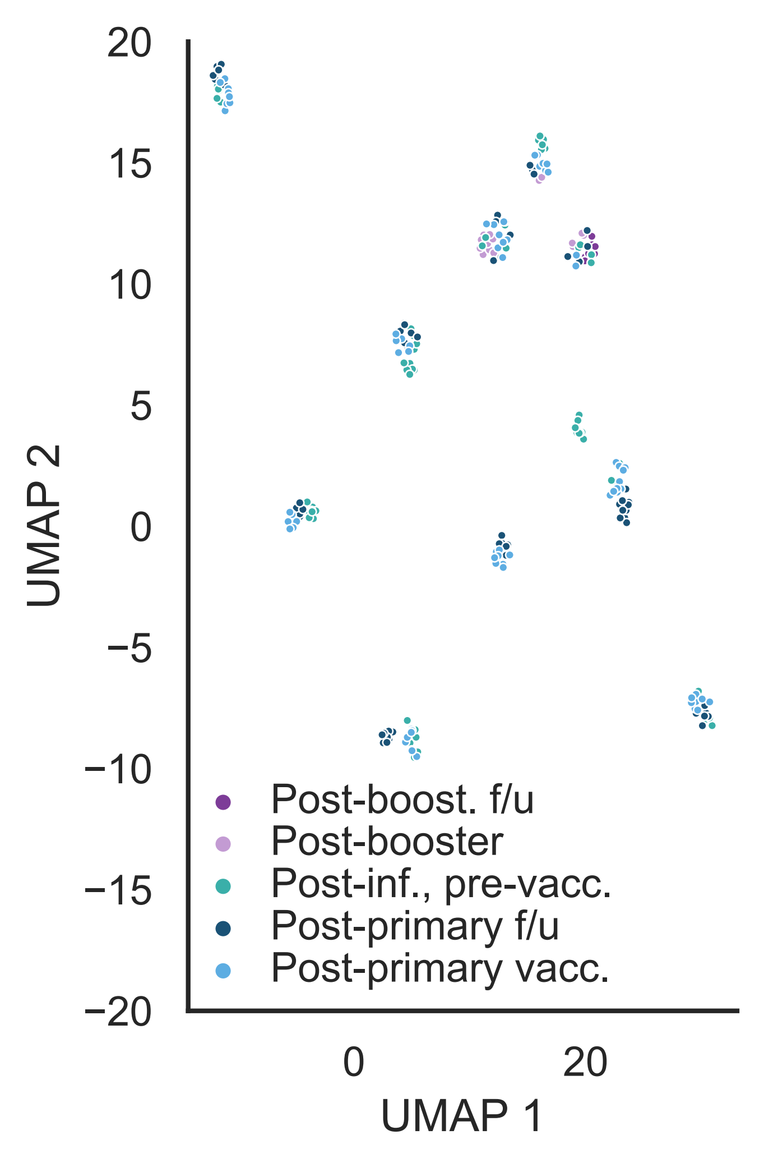
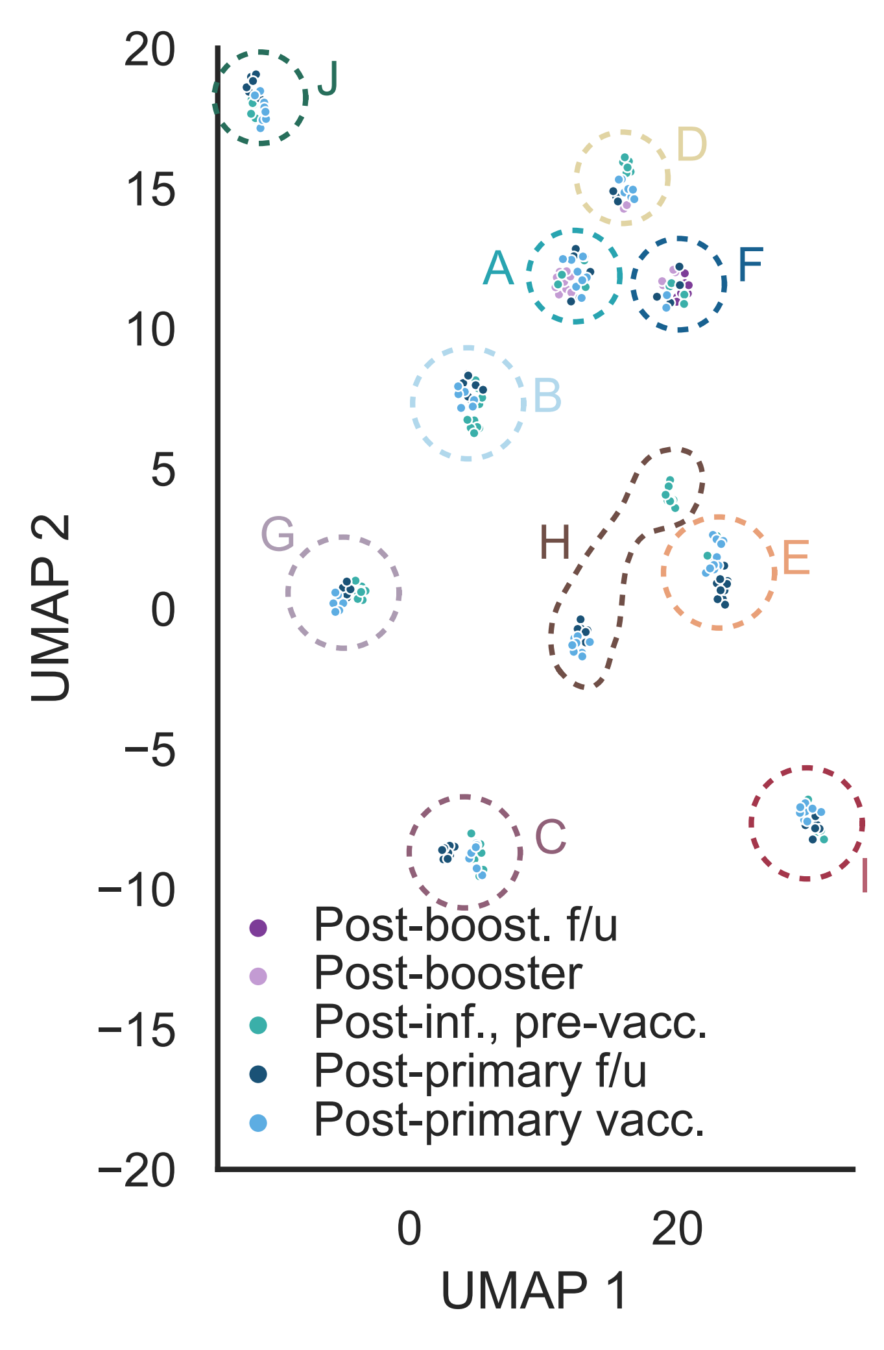
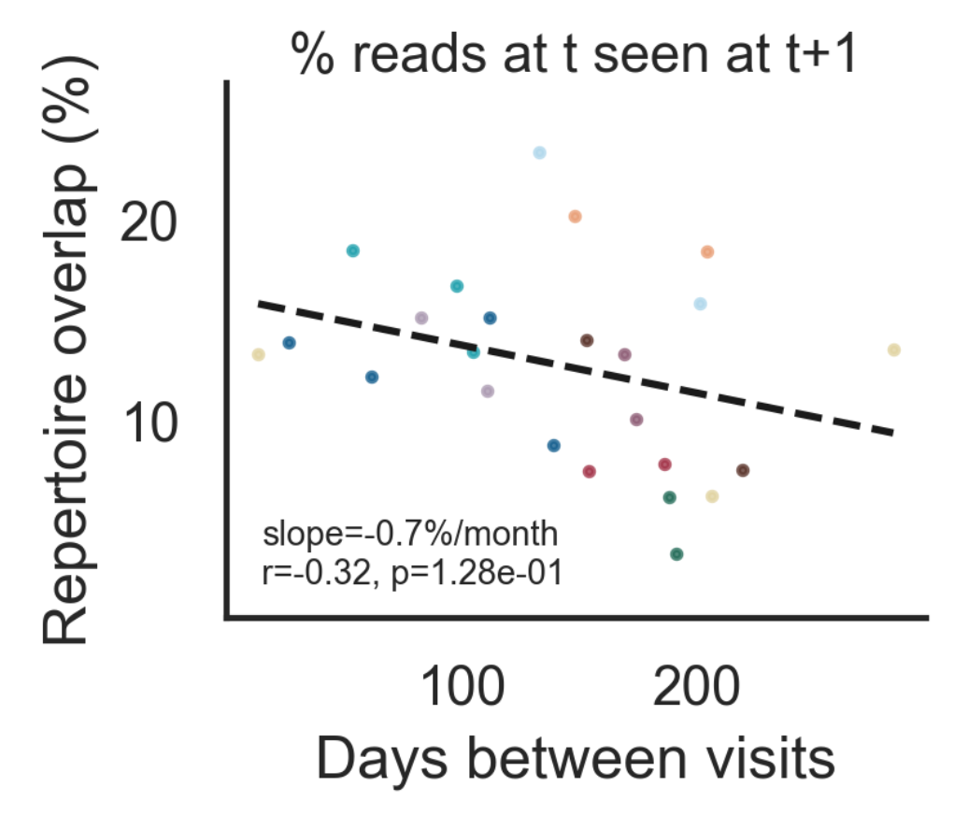
Global statistics don’t show the responding lineages
The repertoire is stable over time
This stability is maintained through turnover

Slide 5
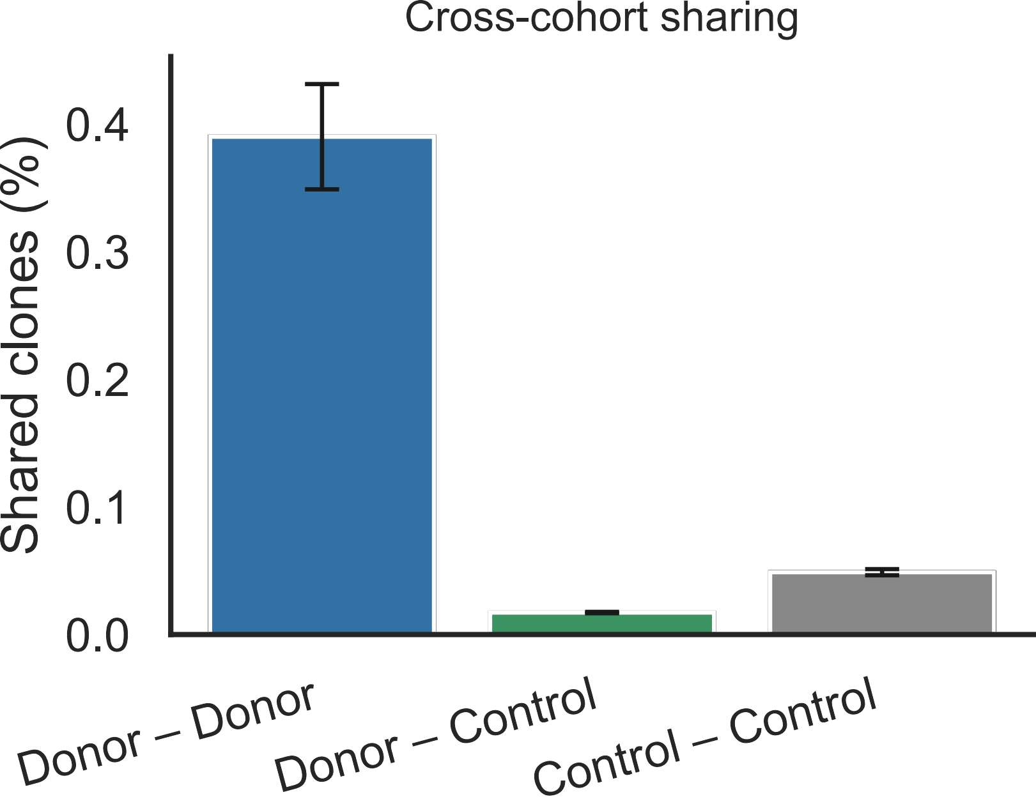
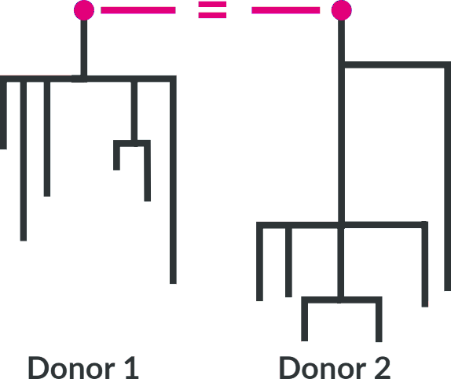
Shared lineages as a proxy for specificity ?
Shared lineages = same unmutated ancestor

Slide 6
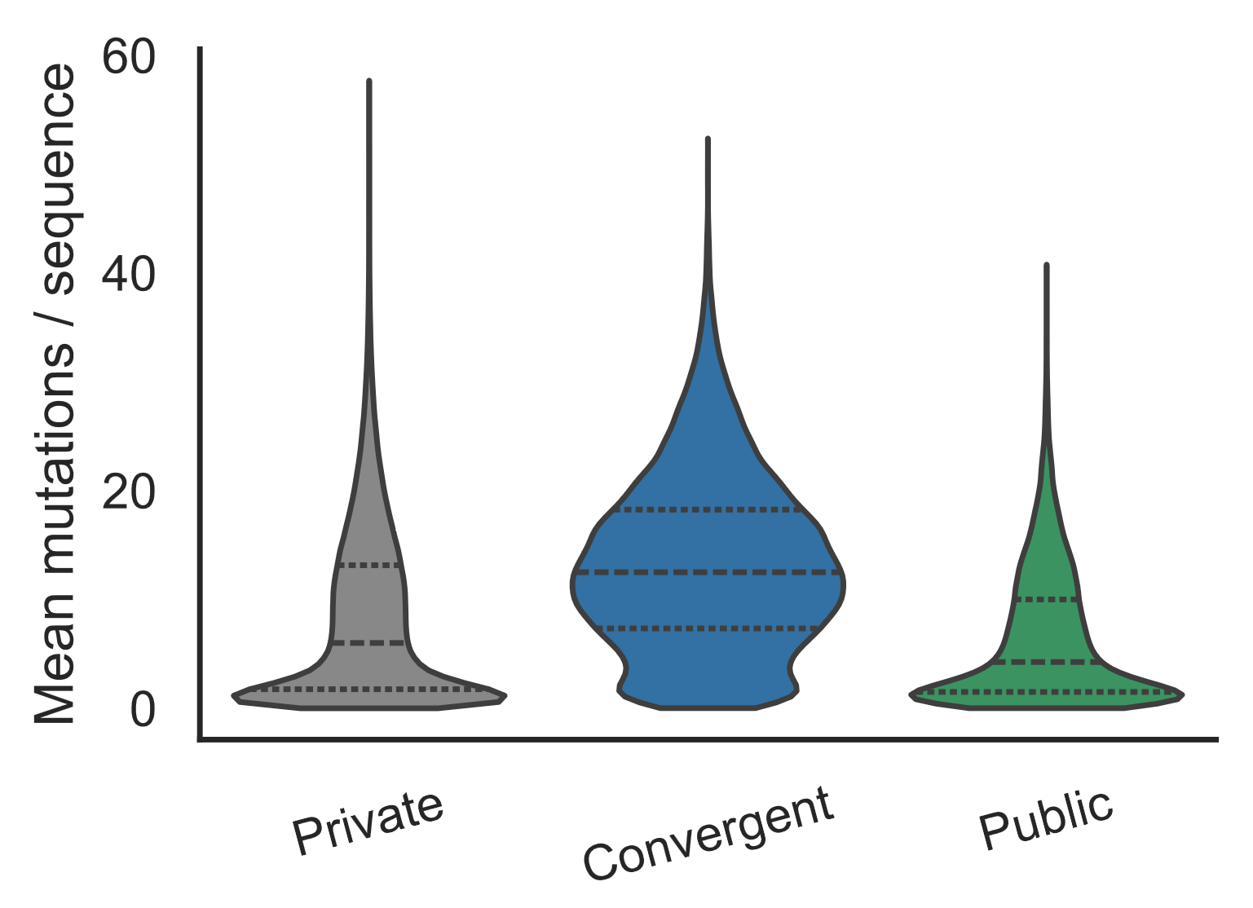
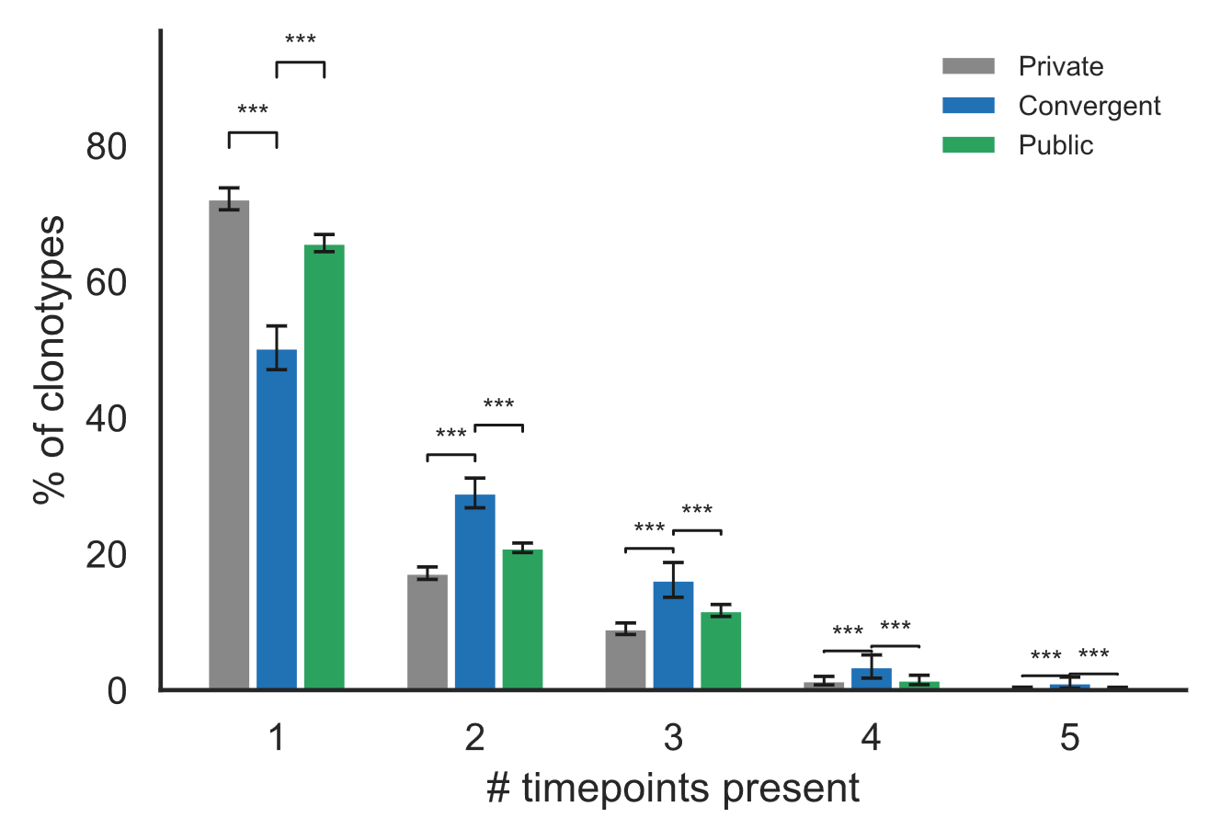
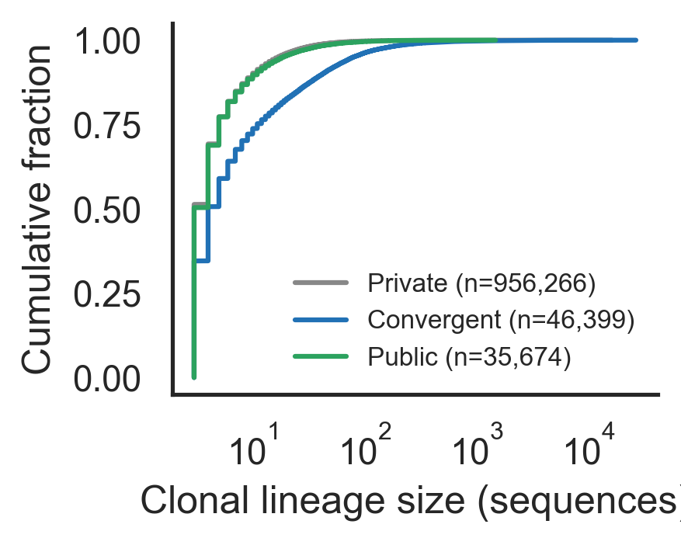
Shared lineages are enriched for response signature
Convergent
Public clones = shared with the healthy controls
Convergent clones = with the cohort
Public clones

Slide 7
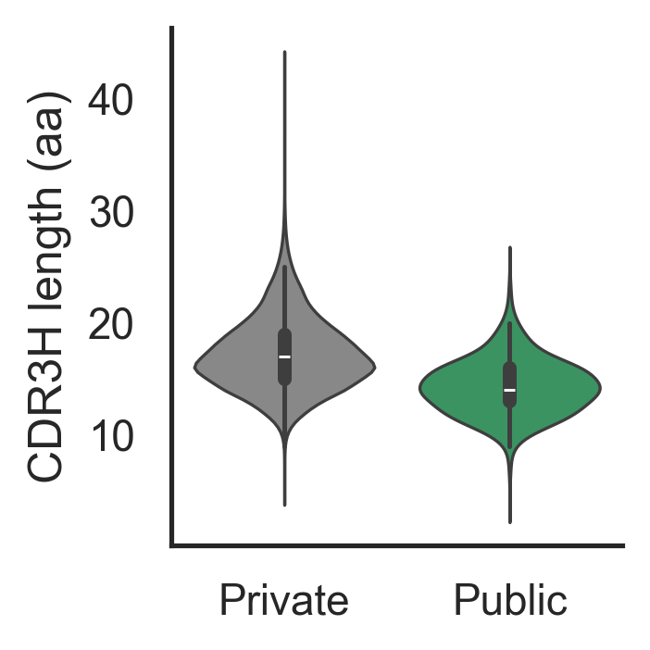
Shared lineages are a biased sample
Shared BCR are shorter, and more often generated by recombination.

Slide 8

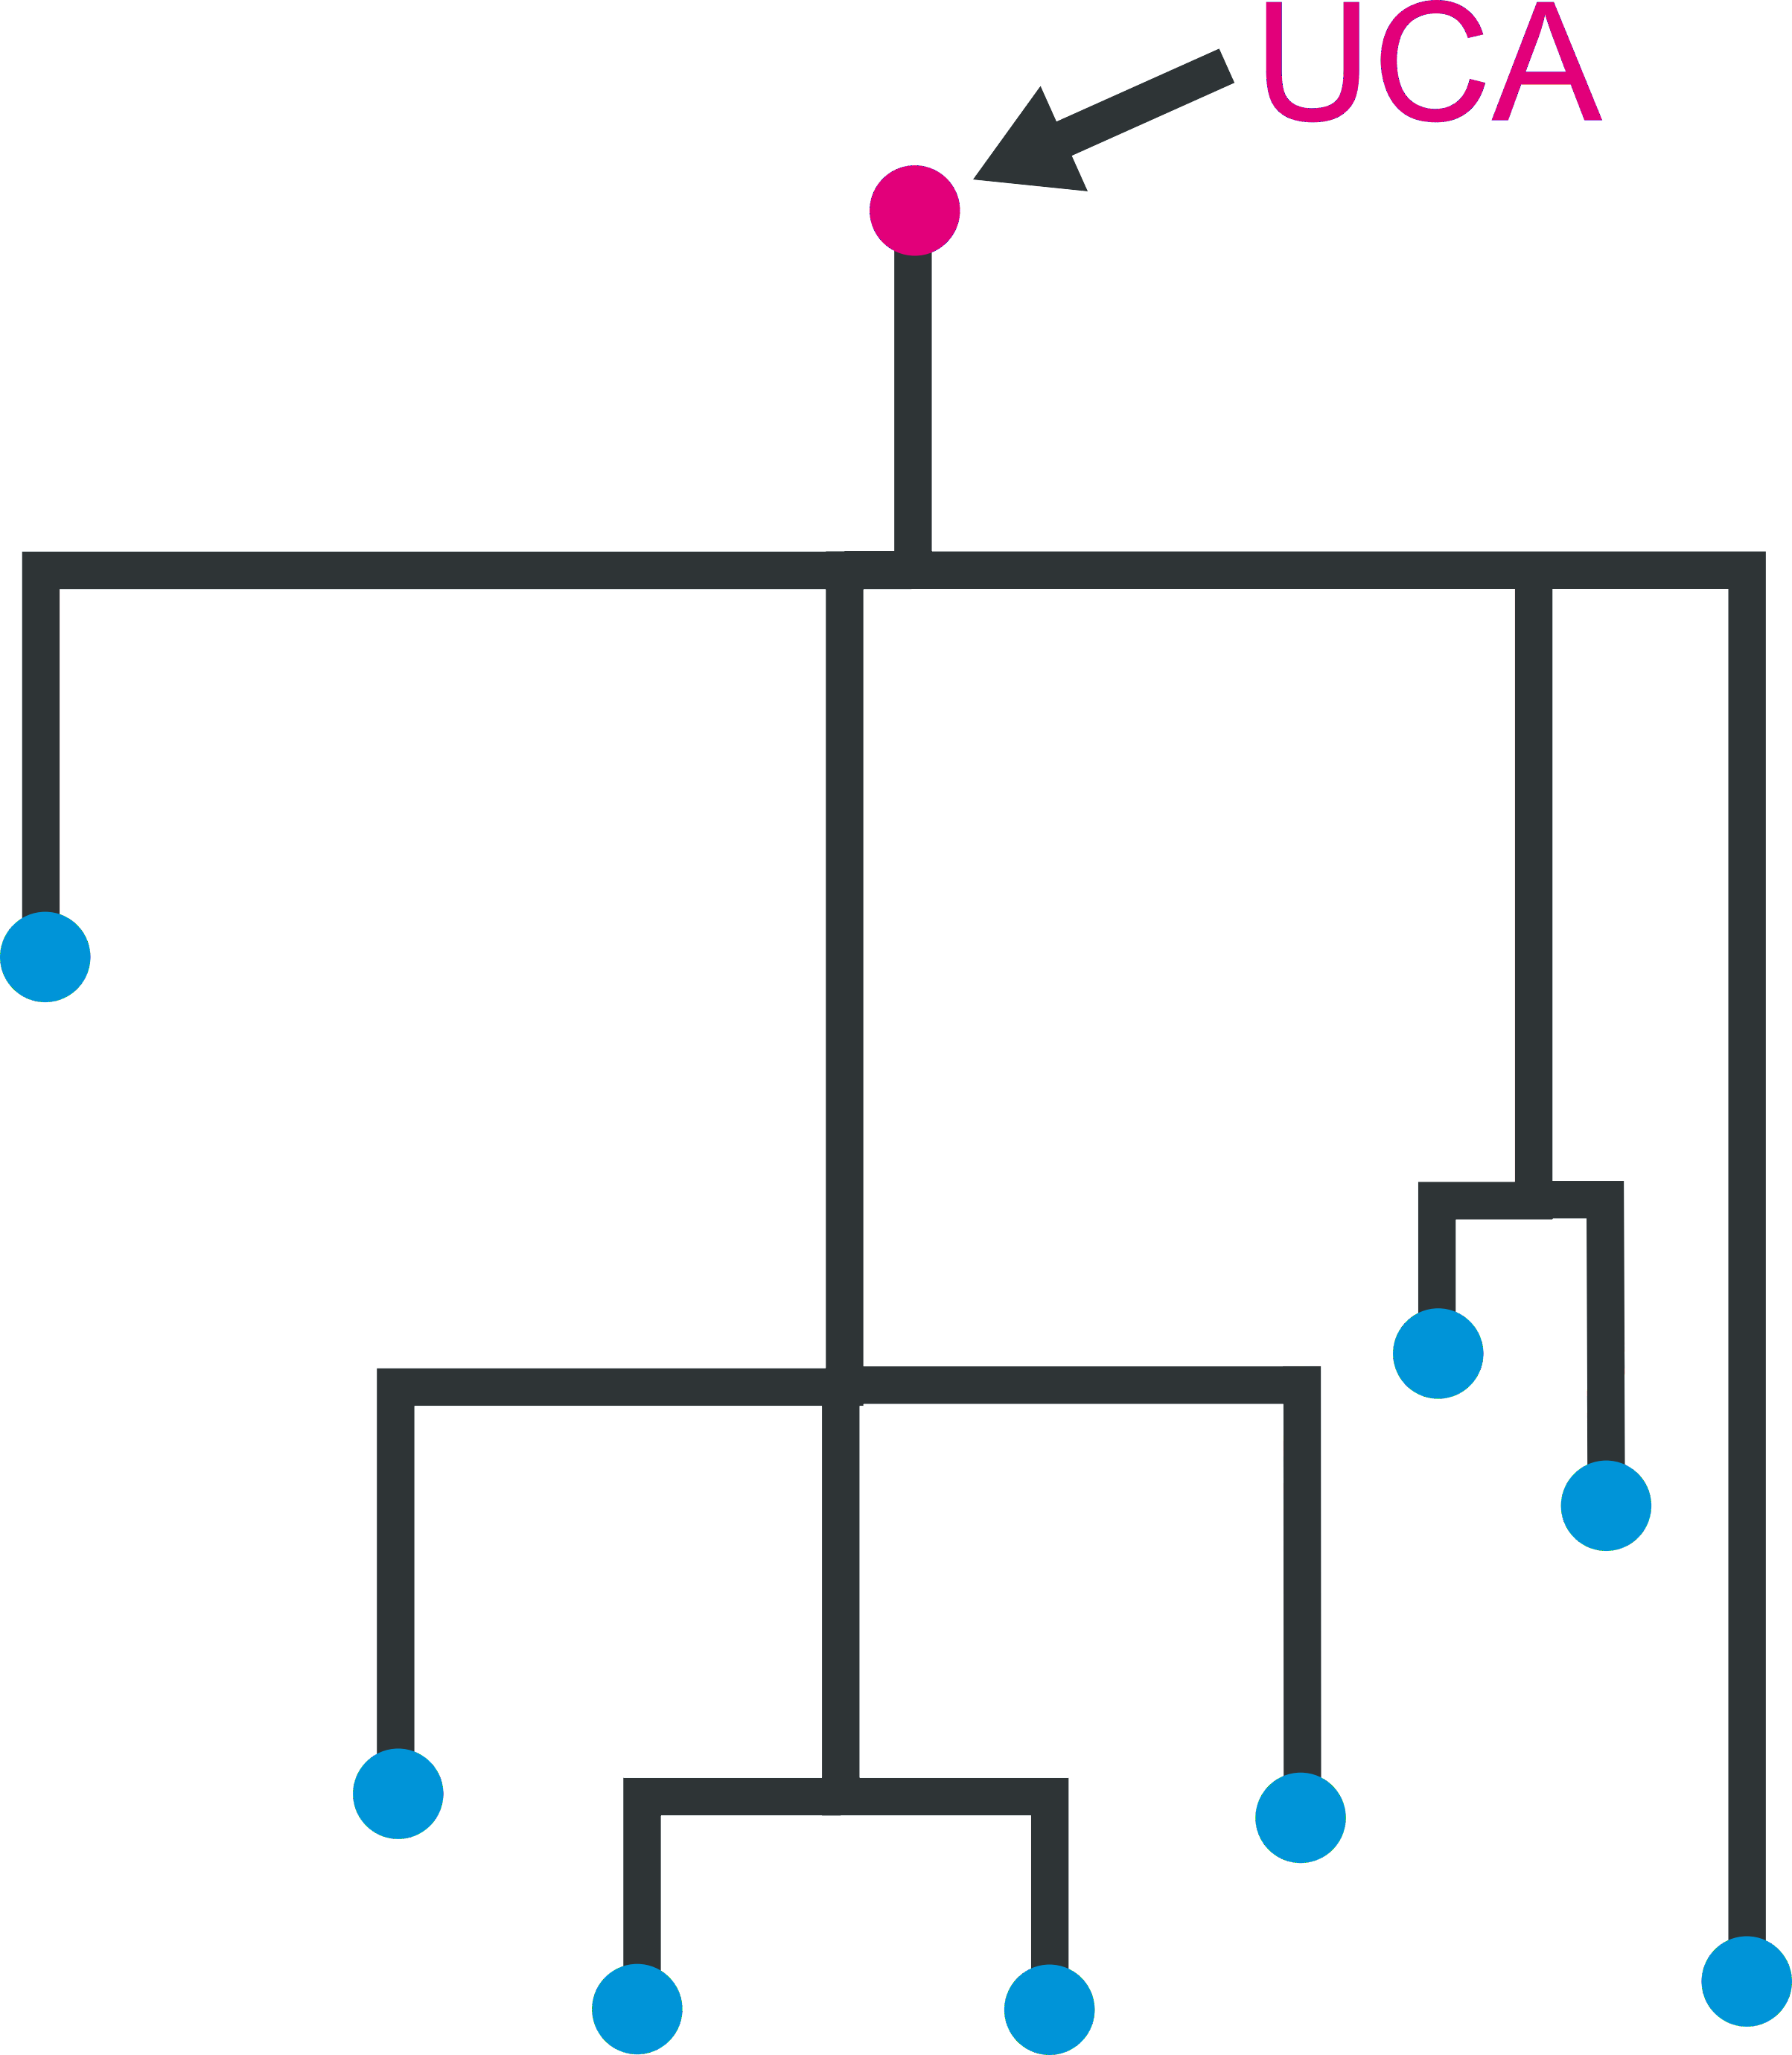
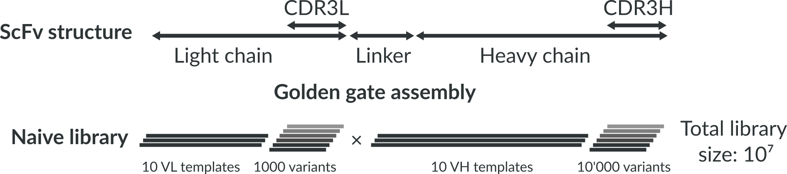
Measuring specificity
In-vitro “clone” of the repertoire.
⇒ Quantitative readout
⇒ Control over the antibodies tested
We recreated the inferred ancestor (UCA) for the largest lineages.
Bulk sequencing ⇒ No heavy-light pairing ⇒ Combinatorial approach

Slide 9
Making the library
We focus on the 10’000 largest clonal lineages.
(still a very small part of the overall repertoire ~ 0.1%)

Slide 10
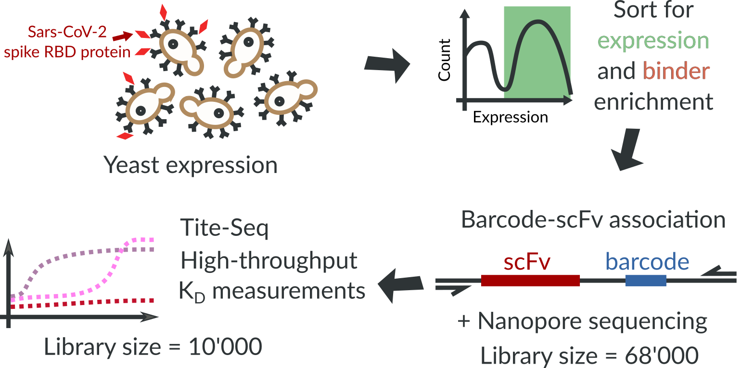
Measuring Affinities in High-Throughput

Slide 11
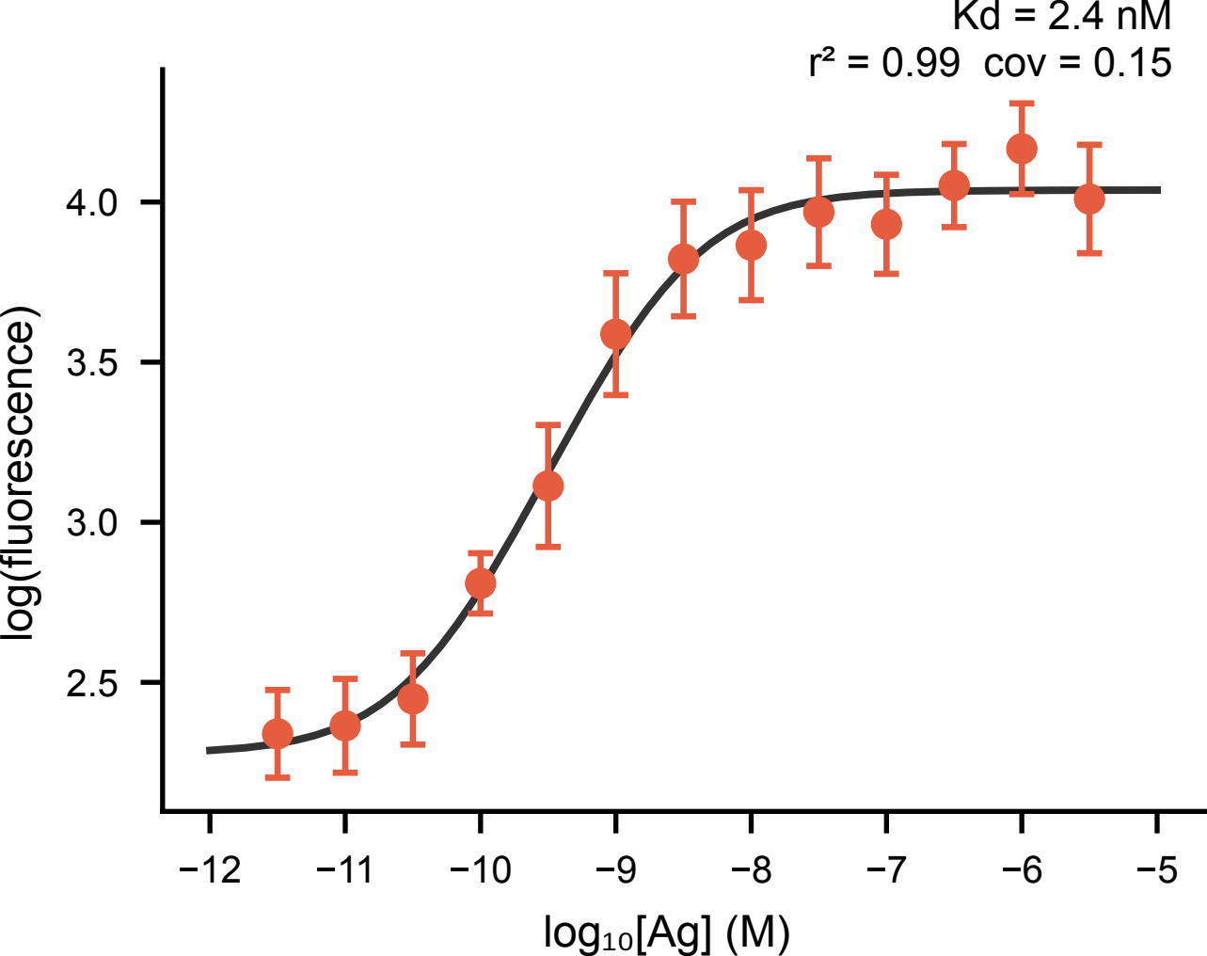
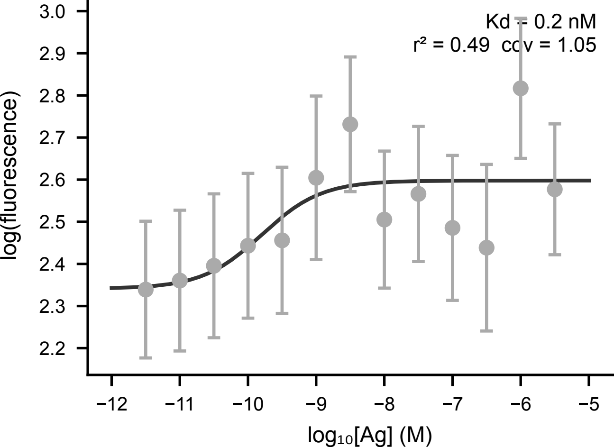
Measuring Affinities in High-Throughput

Slide 12
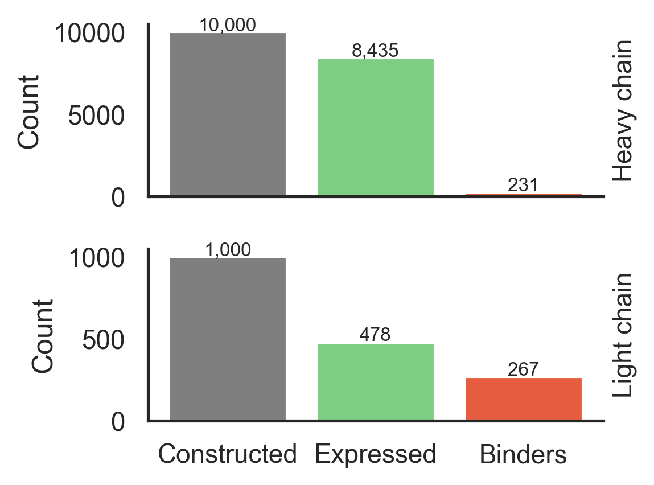
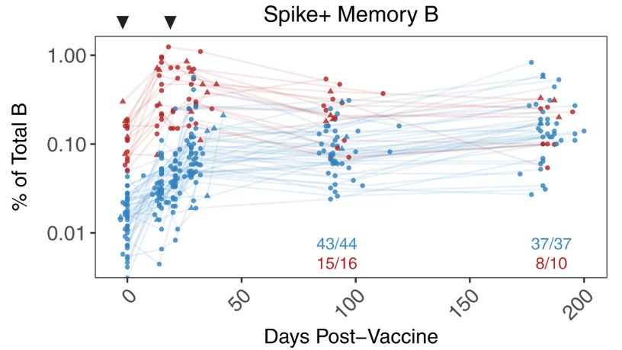
2% of these lineages bind the RBD
Goel, Rishi R. et al. Science (2021)

Slide 13
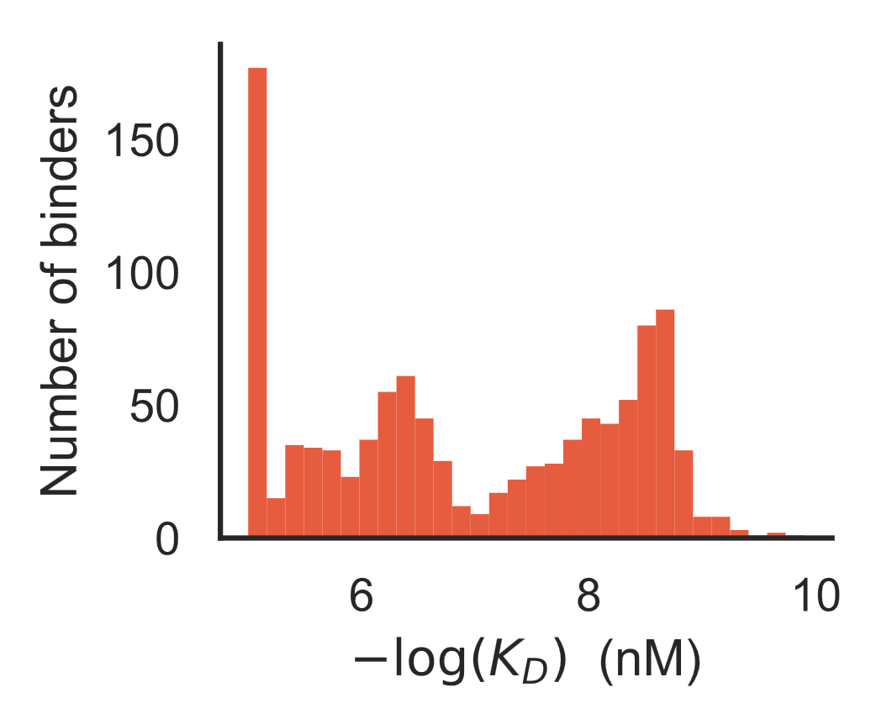
Unmutated ancestors span a wide affinity range

Slide 14
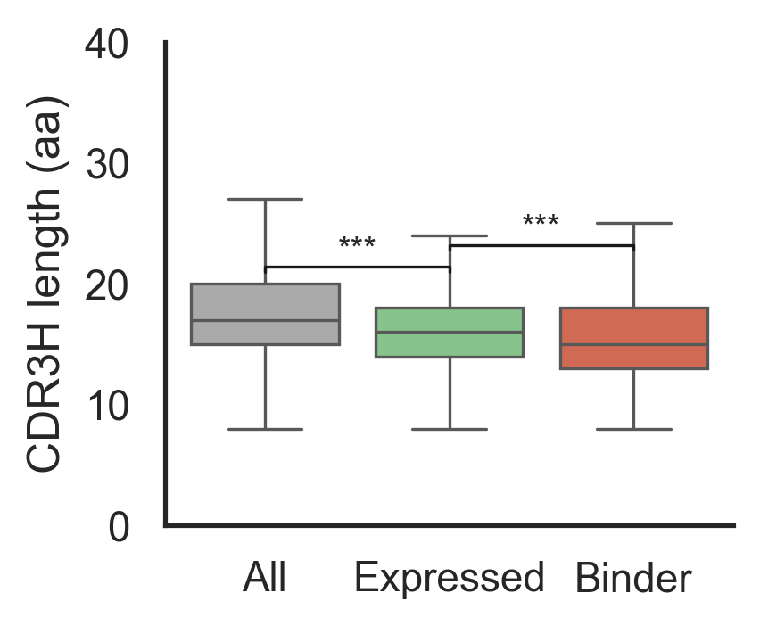
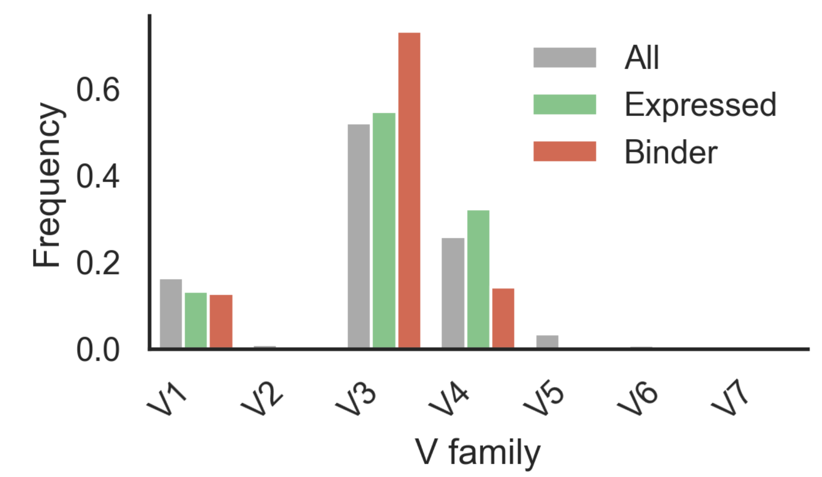
Binders come from across the repertoire
Slightly skewed V-gene distribution
Binders tend to be shorter

Slide 15
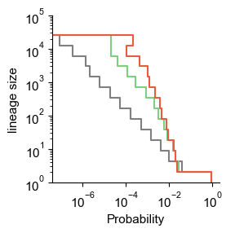
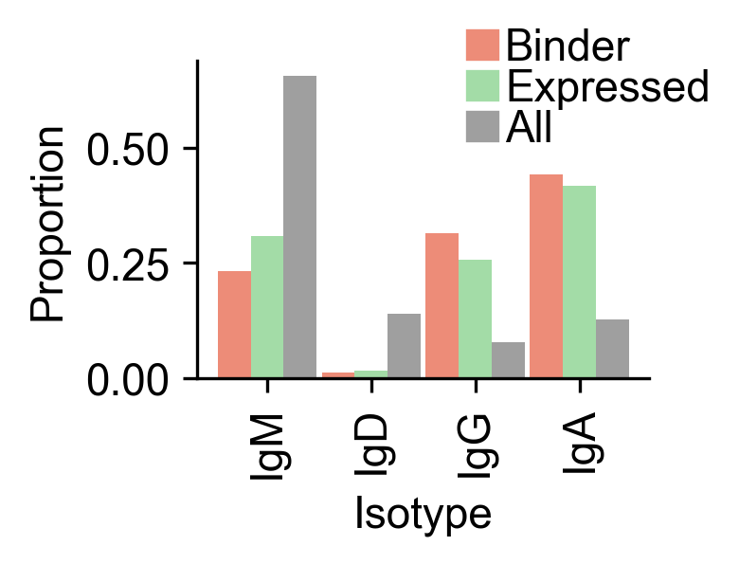
Binder lineages have a response signature
Binder lineages are more often class-switched
Binder lineages are larger

Slide 16
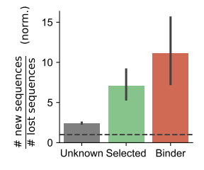
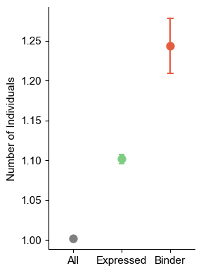
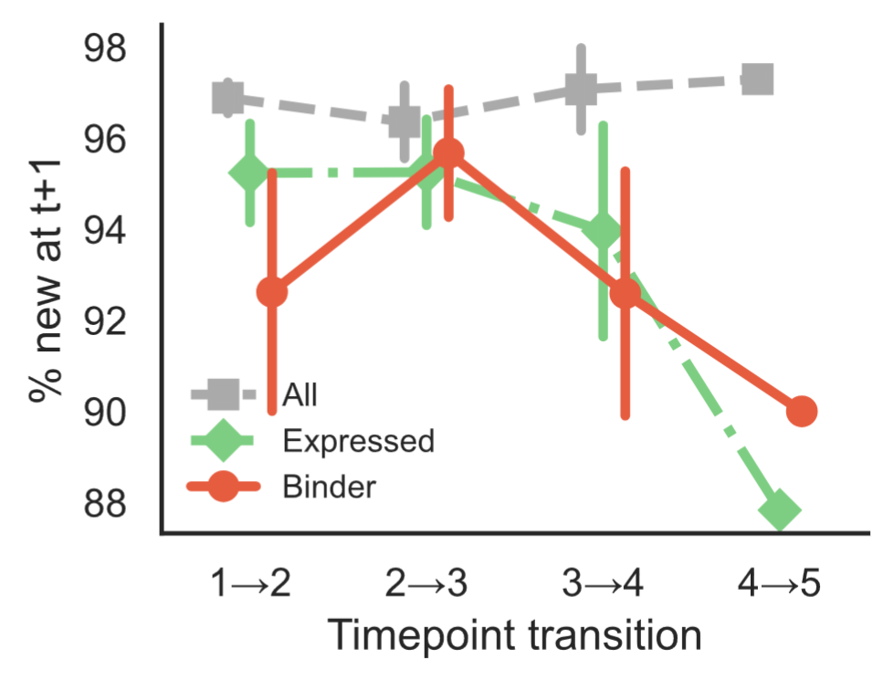

Binder lineages are shared and persistent

Slide 17
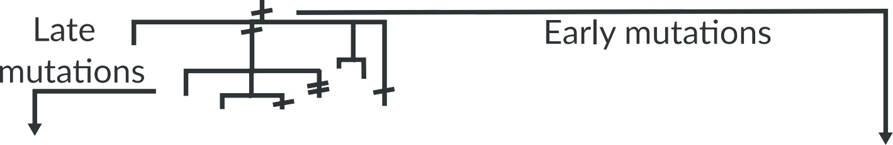

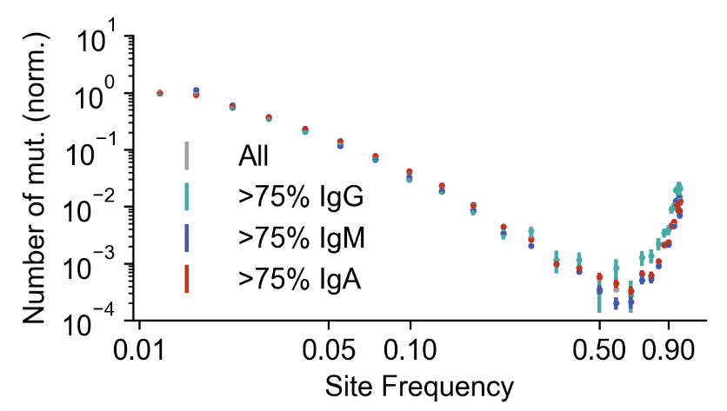
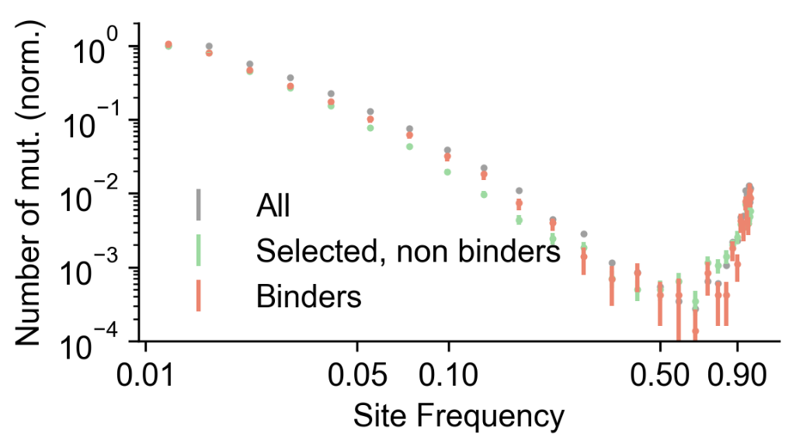

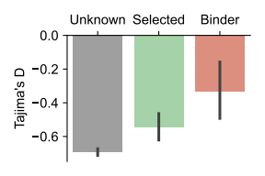
Binder lineages are under stronger selection

Slide 18
Can we identify the responding lineages ?
Binder lineages have distinct properties, but none of them is discriminative enough to identify binders from sequence alone.

Slide 19
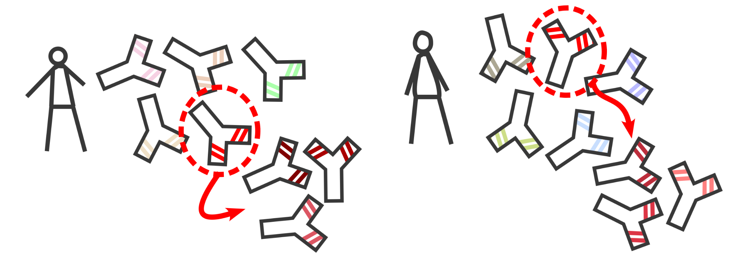
Shared lineages as replicate experiments
Can we predict the evolution of a repertoire?
Will lineages with the same UCA react in the same way in different patients?

Slide 20
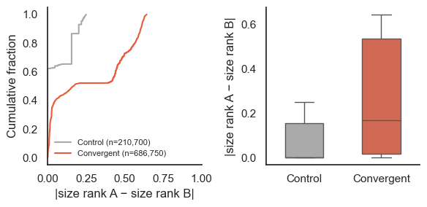
Shared lineages have similar trajectories

Slide 21
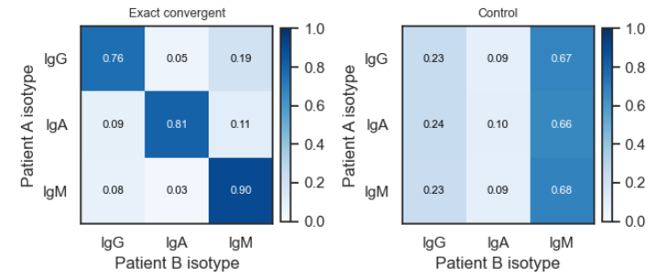
Shared lineages tend to class-switch similarly

Slide 22
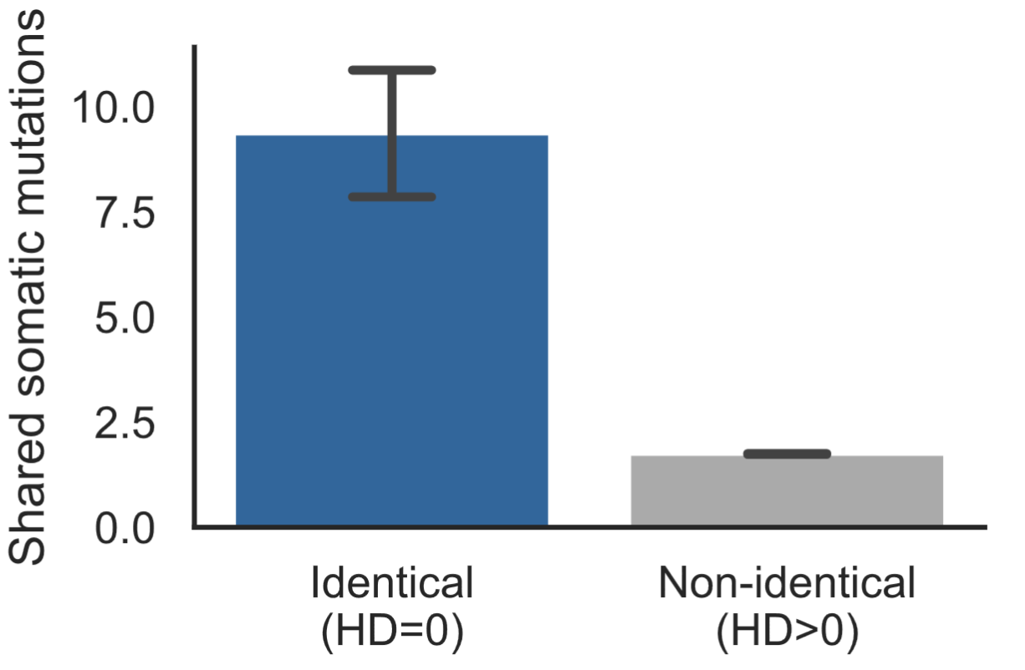
B-cell evolution is reproducible between individuals
Lineages with the same unmutated ancestor accumulate the same mutations

Slide 23
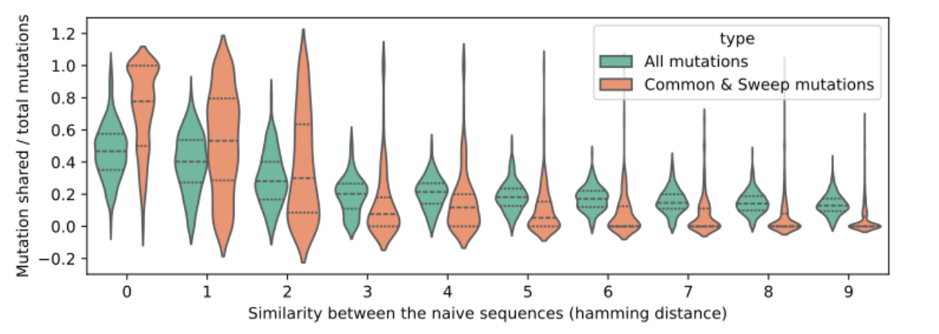
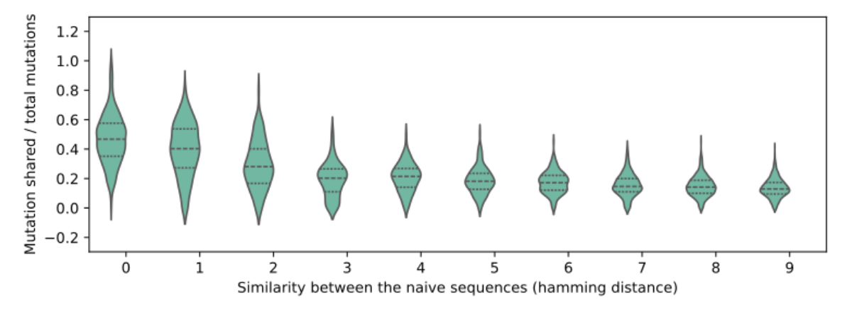
B-cell evolution is reproducible between individuals
But this is less and less true as the distances between the UCAs increase

Slide 24
Summary
Vaccination experiment. 10⁹ B-cells receptors sequenced, 10⁴ antibody-antigen interaction measured
Lineages that bind the antigen have unique properties.
In-repertoire replicates : the same receptors in different individuals follow the same patterns.

Slide 25
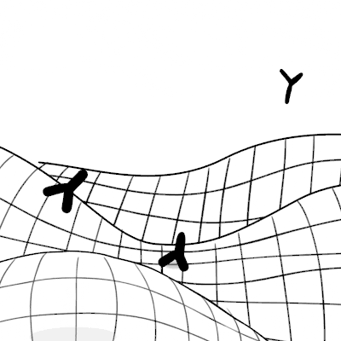
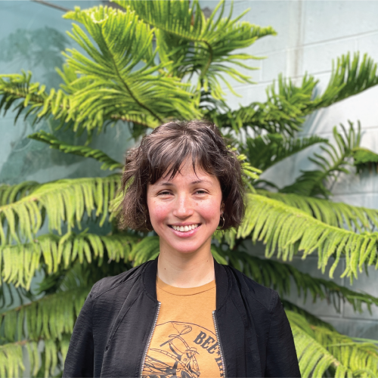
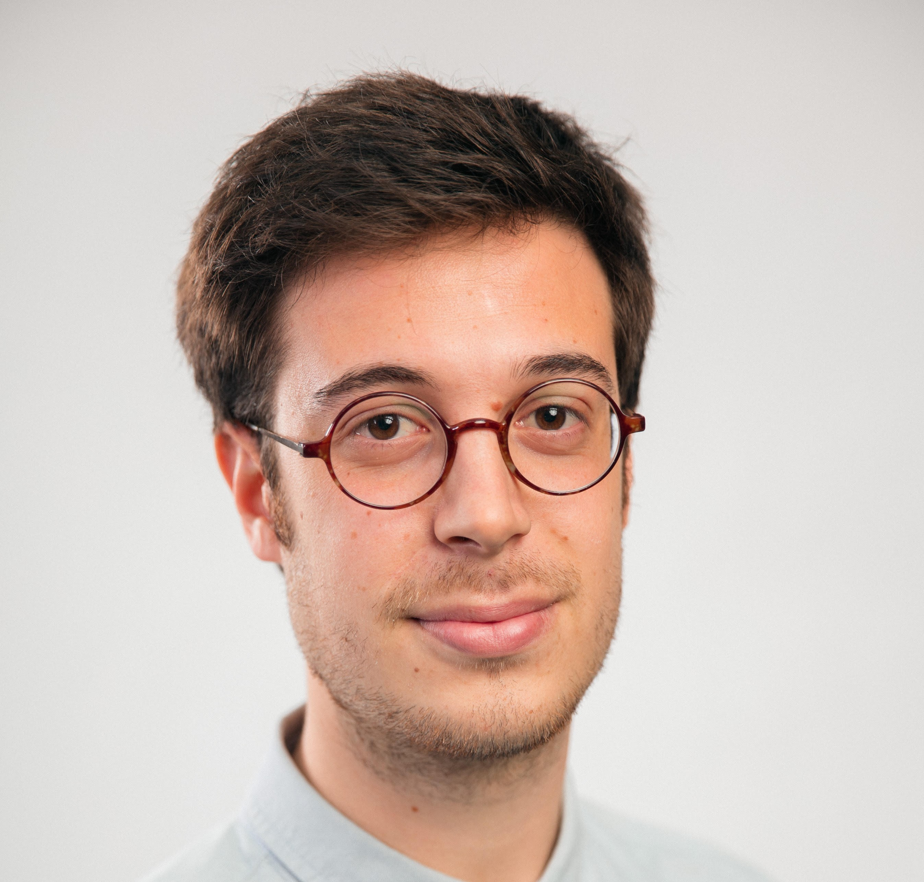
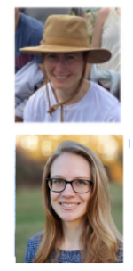

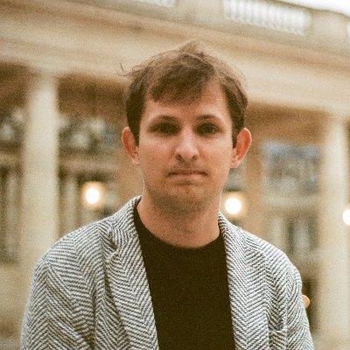
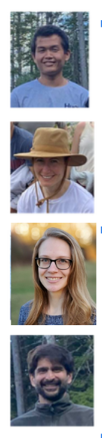

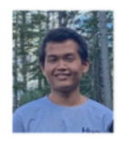
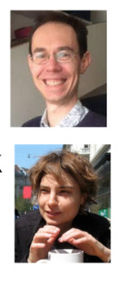
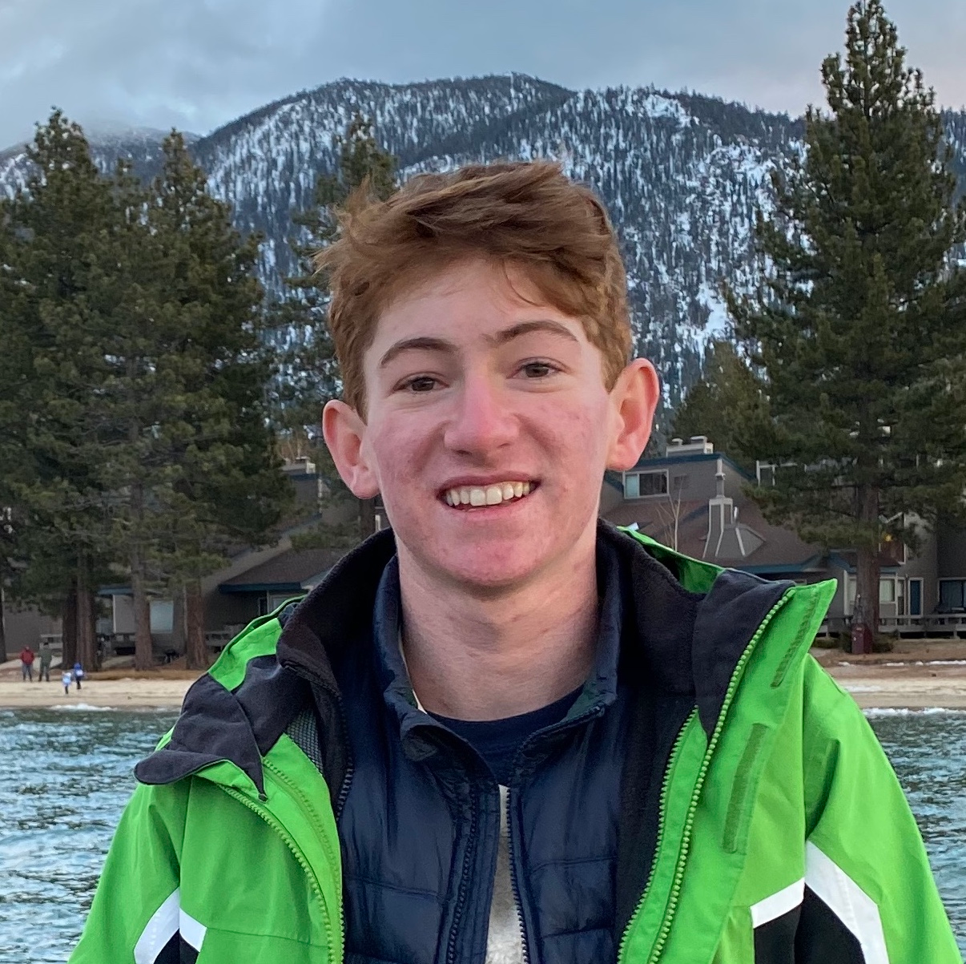
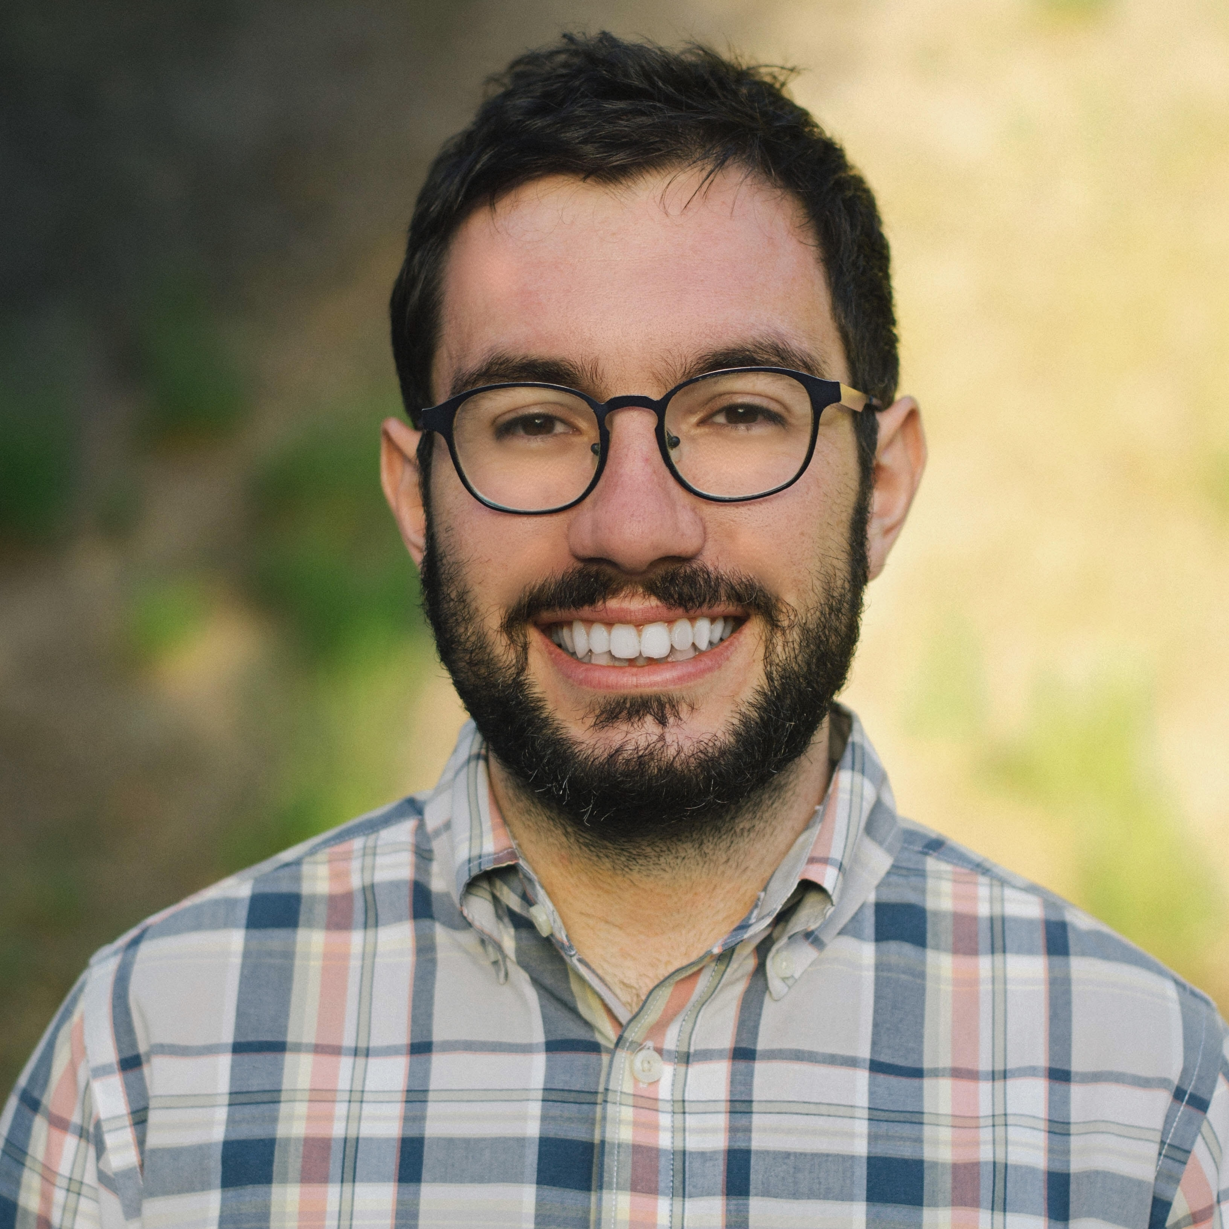

THANKS !
Tatiana Ruiz-Bedoya
Giulio Isacchini
Angela Phillips
Zach Montague
Natanael Spisak
Katherine Lawrence
Michael Desai
Alexandra Poret
Alief Moulana
Thierry Mora
Daniel Newton
Joao Ascensao
Berk Alpay
Aleksandra Walczak
TD Lab
Virginie Chatain
Charlotte Réocreux
We’re looking for a post-doc!
dupic@ciml.univ-mrs.fr
www.thopic.eu

Slide 26
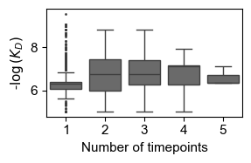
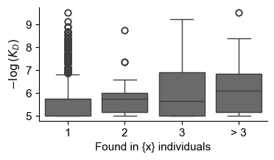
The affinity of the germline sequence matters too !
High affinity germline are more shared
High affinity germline are found across more timepoints

Slide 27

Structural properties
Alphafold is not doing very well here but is showing promise.
UMAP based on Alphafold internal representation. Circled sequences are potential predicted binders.

Slide 28


Functional Characterization of the Antibodies
Yeast display expression of antibodies
Fluorescent antigen
ScFv format

Slide 29



Affinity Measurement in High-Throughput, Tite-Seq
Adams, R. M., et al. eLife (2016)
Incubation at a fixed antigen concentration
⇒ Estimate the average proportion of antigen bound to each distinct antibody
4-ways sort &
sequencing

Slide 30



Affinity Measurement in High-Throughput, Tite-Seq
Repeat at different antigen concentrations to create the full titration curve.
Versus titration
Versus Bio-Layer interferometry
Philips, A. M., Lawrence, K. et al., eLife (2021)
Moulana, A., Dupic, T. et al., Nat. Comm. (2022)
Moulana, A., Dupic, T. et al., eLife (2023)...
Phillips, A. M. et al, eLife (2023)

Slide 31

From one clonal lineage to the repertoire
Real responses are multi-clonal
How many lineages are responding
to the antigen(s) ?
What are their properties ?
Can we detect them computationally ?

Slide 32




Antibody response during Vaccination
Vaccination as a model for studying the repertoire response: known antigens & known timecourse.

Slide 33


PBMC B-cell response to SARS-CoV-2 vaccination
Short term (< 6 weeks): Plasmablast and antibody production
Turner, J. S. et al. Nature (2021)
Long term:
Memory B-cells
0.1-1% of the total B-cells are spike+
Goel, Rishi R. et al. Science (2021)

Slide 34
Antibody response during Vaccination
Following the evolution of the BCR repertoire alongside SARS-CoV-2 vaccination.
1. Long-term response
2. High depth
3. Functional characterization

Slide 35

Samples timeline
Longitudinal sampling on 10 individuals. Collaboration with the Yu lab at the Ragon institute, 10⁹ B cellls.

Slide 36



Sequencing
Deep bulk repertoire sequencing of heavy and light chains, 34 samples × 5 replicates.
The stack:
- MiXCR
- Hilary for clonal reconstruction
- IGoR for recombination model
- Igonometree for tree reconstruction

Slide 37




The Immune Repertoire
Repertoire change a lot but their statistical property don’t.

Slide 38


Making a library
BCR frequencies follow “power-law” distribution
We focus on the 10’000 largest clonal lineages.
(still a very small part of the overall repertoire ~ 0.1%)

Slide 39

Making a library
Bulk sequencing limitation: no heavy-light pairing
Focus on the reconstructed naive sequence
⇒ Combinatorial approach

Slide 40
Functional characterization

Slide 41





Binders
Tite-Seq allow us to differentiate cleanly binders from non-binders
Measured KD:
2% of the heavy repertoire binds !

Slide 42


A diverse response
Binder lineages come from all V-genes (that we tested) and have diverse CDR3 lengths

Slide 43

Properties of the “binding” lineages
Binder lineages are larger
Binder lineages are more likely to be “public” among vaccinated individuals

Slide 44
Properties of the “binding” lineages
Lineage with binding germlines are more reactive
Binder lineages are more often class-switched

Slide 45

Binder lineages evolve differently
Evolutionary metrics differ between binders and non-binders
By contrast, no differences between isotypes

Slide 46


Structural properties
The light chain is crucial for specificity

Slide 47
THANKS !
TD Lab
Tatiana Ruiz-Bedoya
Giulio Isacchini
Angela Phillips
Zach Montague
Natanael Spisak
Katherine Lawrence
Michael Desai
Alexandra Poret
Alief Moulana
Thierry Mora
Daniel Newton
Joao Ascensao
Berk Alpay
Aleksandra Walczak
Virginie Chatain
Charlotte Réocreux
dupic@ciml.univ-mrs.fr
www.thopic.eu

Slide 48
Structural properties
Alphafold is not doing very well here but is showing promise.
UMAP based on Alphafold internal representation. Circled sequences are potential predicted binders.

Slide 49


We are recruiting up to two new team leaders.
Advancing Immunology Together
200 scientists • 16 research teams
State‑of‑the‑art facilities:
Flow cytometry • Imaging • Genomics • Histology • Computational biology • CRISPR screening
Start‑up package:
Fully equipped lab • Salary • 2‑year consumables funding • Free core facilities
Application deadline: May 1st 2026
Contact: milpied@ciml.univ-mrs.fr
https://ciml.univ-mrs.fr

Slide 50

How reproducible is affinity maturation ?
Use identical lineages in different patients as independent replicates
Are B-cells evolving the same way across individuals ?

Slide 51


Mutational Convergence
Same V gene
Identical ancestors share more mutations than expected in different individuals

Slide 52
Mutational convergence
What about sequences that are not exactly shared, but similar between individuals ?

